Slide 1
Magic Beans Demo Presentation
Alex Laurent, Nick Bolles, Topher Witt, Rich Sanchez

Slide 2
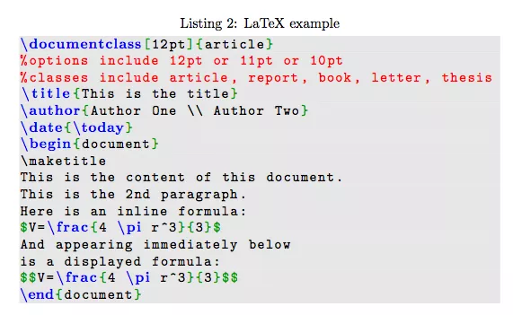
What is Latex?
Text editor for accurate editing of official documents
Uses code-like syntax for formatting

Slide 3

What is Magic Beans?
Magic Beans is a NetBeans plugin that allows users to edit Latex within NetBeans

Slide 4
How Does Magic Beans Work?
Connecting directly to Netbeans Architecture
Module Suite
Creating Latex project type
Jpanel pdf preview, syntax highlighting, tree navigation pane

Slide 5
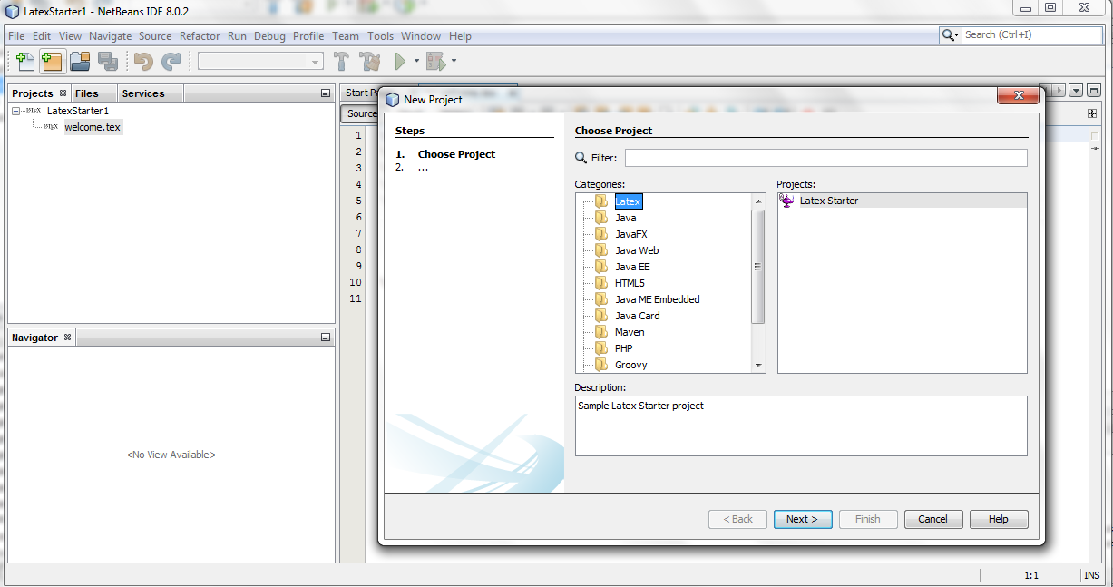
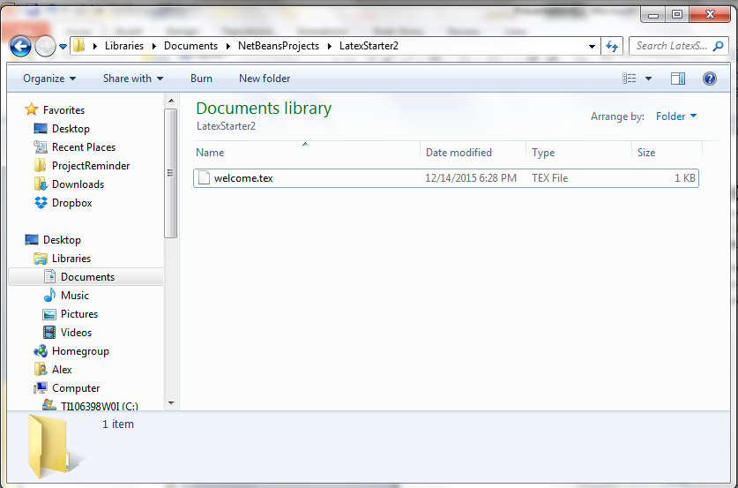
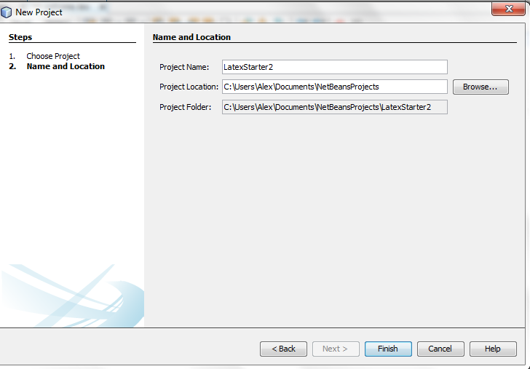
Screenshots

Slide 6
What Makes Us Different?
More directly integrated with NetBeans than any Latex NetBeans plugin
PDF preview in the same window and tab for side by side comparison
Project type capability

Slide 7
Issues
Understanding LaTeX, what it is, how it works
Learning the Netbeans architecture proved very hard
Because of this choosing an approach was difficult and we had to change directions 3+ times which came with re-learning
Connecting our plugin to LaTeX
Getting the rendered PDF back from the executable

